Slide 1
GIT HUB Branching & Merging
Presented by Adam, Justin, Kalin & Ashley

Slide 2
Basic Git Commands
Git Commands
git init
git clone <repo URL>
git Status
git add –A
git add .
git add -u
git add <file-name>
git commit –m’some comment’
git push
git pull
What They Do
Initializes Repo
Clones the repo to a location
Gets the current branch status
Adds ALL files to the staging area
Without deleted
Without new
Adds the specified file to stage
Commits all staged files
Pushes the changes to GitHub
Grabs any changes from GitHub

Slide 3
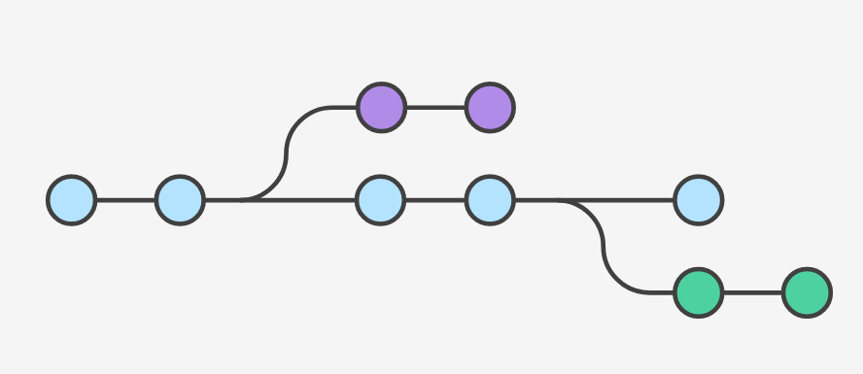
GIT BRANCH
You can think of them as a way to request a brand new working directory, staging area, and project history. New commits are recorded in the history for the current branch, which results in a fork in the history of the project.
This makes sure that unstable code is never committed to the main code base, and it gives you the chance to clean up your feature’s history before merging it into the main branch.

Slide 4
Git Branchy
Common Git Branch Commands
git branch
git branch <branch-Name>
git checkout ‘branch-Name’
git branch -d <branch-Name>
git branch –D <branch-Name>
What it means
List all branches
Makes the new branch
Switch to named branch
Safely Delete the named branch
Non safe way to delete branch

Slide 5
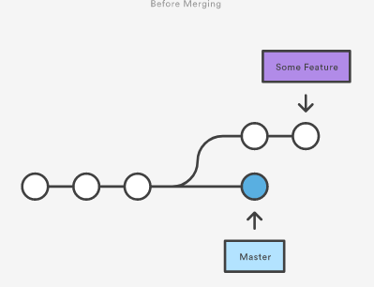
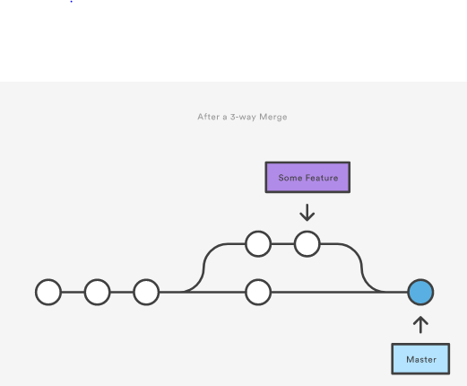
GIT Merge
Merging is Git's way of putting a forked history back together again. The git merge command lets you take the independent lines of development created by git branch and integrate them into a single branch.
Once you’ve finished developing a feature in an isolated branch, it's important to be able to get it back into the main code base. Depending on the structure of your repository, Git has several distinct algorithms to accomplish this: a fast-forward merge or a 3-way merge.

Slide 6
Git Mergey
Common Git Merge Commands
git branch
git branch <branch-name>
git merge <branch-name>
git Status
Handy for dealing with conflicts
What They Do
List all branches
Creates a new branch
Merges named branch to current branch
Shows status of current branch

Slide 7
Dealing With Conflicts
Some times if you edit the same line in a file as a team mate and attempt to merge git will not know what to do and fail to merge that file. When you see the failed to merge error, git status is your friend. You will have to manually fix the code before you can merge. Git will add
<<<<<<<<<<<<<<<<
<Master Code>
===============
<branch code>
>>>>>>>>>>>>>>>>
t0 your code to help you understand and fix where the conflict is at.
These conflicts MUST be fixed before you can sucefuly merge your code!

Slide 8
Fast-Forward Merge
Occur when there is a linear path from the current branch tip to the target branch. Instead of “actually” merging the branches, all Git has to do to integrate the histories is move the current branch tip up to the target branch tip. This effectively combines the histories, since all of the commits reachable from the target branch are now available through the current one.
However, a fast-forward merge is not possible if the branches have diverged.

Slide 9
3-Way Merge
3-way merges use a dedicated commit to tie together the two histories. The nomenclature comes from the fact that Git uses three commits to generate the merge commit: the two branch tips and their common ancestor.

Slide 10
Now Try it yourself!
https://github.com/KalinBowden/BeDapperDesigns
Open git Bash or git kraken
git clone https://github.com/KalinBowden/BeDapperDesigns.git
git branch
git branch <Pick any name>
git checkout yourBranchName
Edit the Title tag in the head of index.html
git add –A
git commit –m’Some comment’
Now Switch between the branches and look at the Title tag
git checkout master
git merge <branch-name>
Look at the Title tag file now

